Slide 1
Container Orchestration
Priyanka Naik

Slide 2
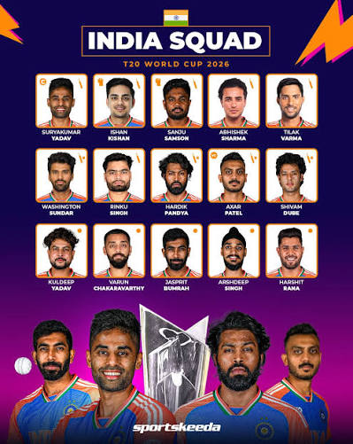
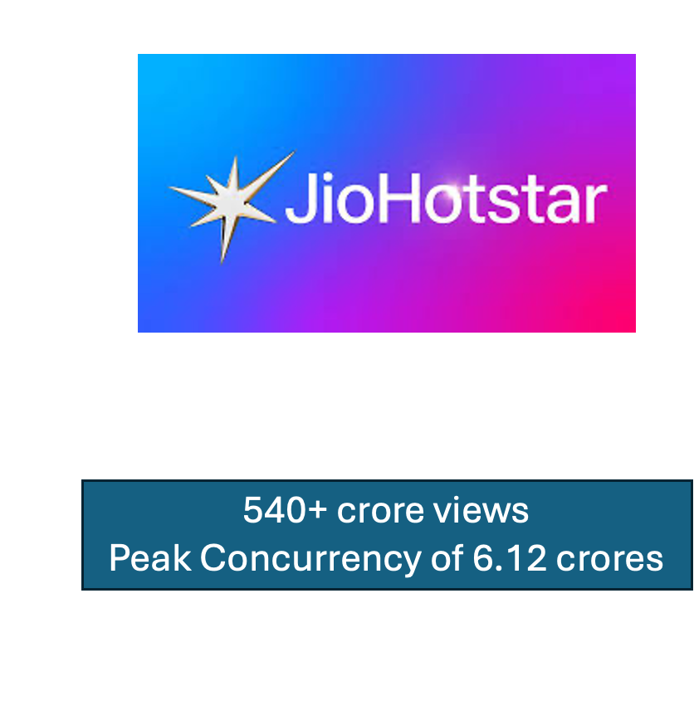

Slide 3
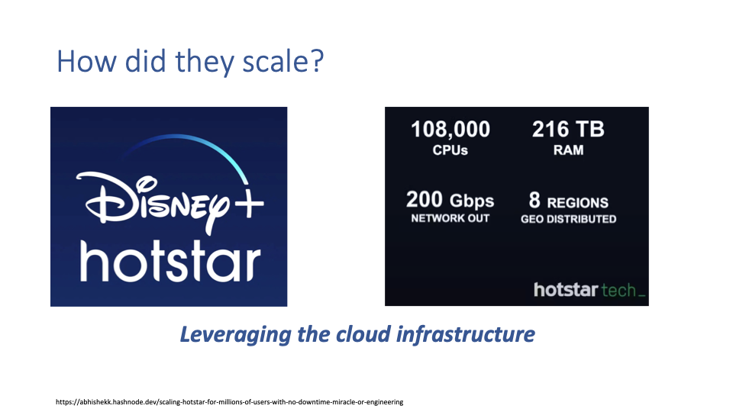
Notes:
Replace with iit b keynote talk

Slide 4
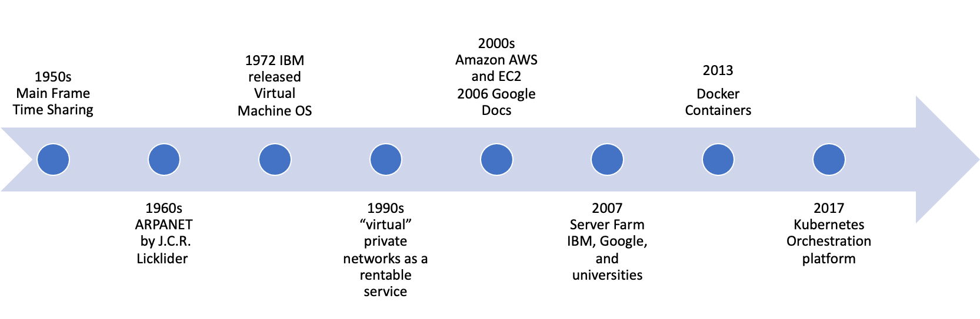
Cloud Evolution

Slide 5
History of application deployment

Slide 6

Monolithic applications
frontend
db
Single executable
Tight coupling
Huge code base
Client

Slide 7
Microservices
frontend
db
Multiple small services
Loose coupling
Ease of managing/scaling individual service
Client

Slide 8

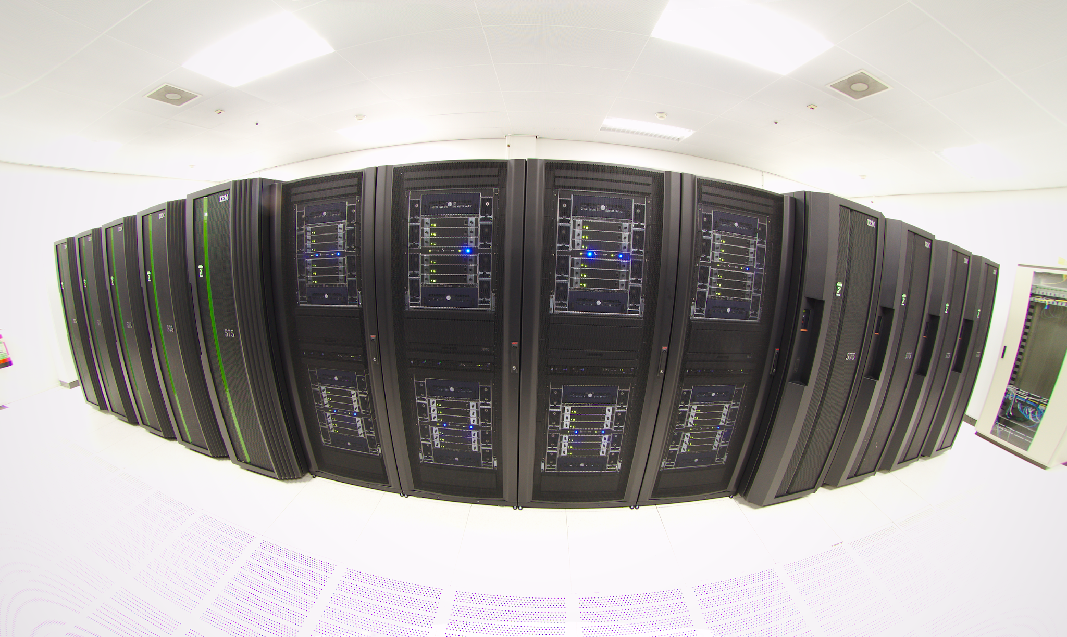
Cloud deployments
Microservice architecture enables easy deployment on cloud
Run large compute, storage task on the cloud
frontend
db
Client
Notes:
Types of cloud hybrid and all here?

Slide 9
Virtualization
Process Virtualization:
Run a process/application as is on different underlying machine architecture. E.g. Java Virtual Machine (JVM)
System Virtualization:
Run a machine over a machine
Enables running multiple virtual machine on a single physical machine
Enabled through hypervisor/virtual machine monitor
VM
VM
VM
VM
application
Guest OS
Hypervisor
Host OS
Physical Machine
Notes:
Process Virtualization technology ensures that a Task is executed exactly as if it is being executed on the computer that initiated the Job (Initiating Machine), regardless of the remote Agent's file system, installation base, and environment.

Slide 10
Downsides of VMs
Heavy-weight - need to run guest OS …
Consume a lot of resources to run
Are very large in size - typically in GBs
Need something that is more lightweight that still gives us isolation and a reproducible environment
VM
VM
VM
VM
Proc
Proc
Proc
Proc
Hypervisor
OS
Notes:
Interrupts still need to be handle with the exit

Slide 11
Containers
Lightweight virtual machines without guest OS
Isolation - no interference between 2 processes
How does it achieve this:
Namespace: isolated view of resources like file system, network resources
cgroups: Resource limit per process/container

Slide 12
What is Docker
Helps developer to build, deploy, update, and run containers.
Portability: Saves time spent on setting up the environment and testing the application
Simple and Fast: Users have to put their configuration into the code and deploy it.
Isolation: Every Docker container has its resources isolated from other containers
Security:control over container management and traffic flow

Slide 13
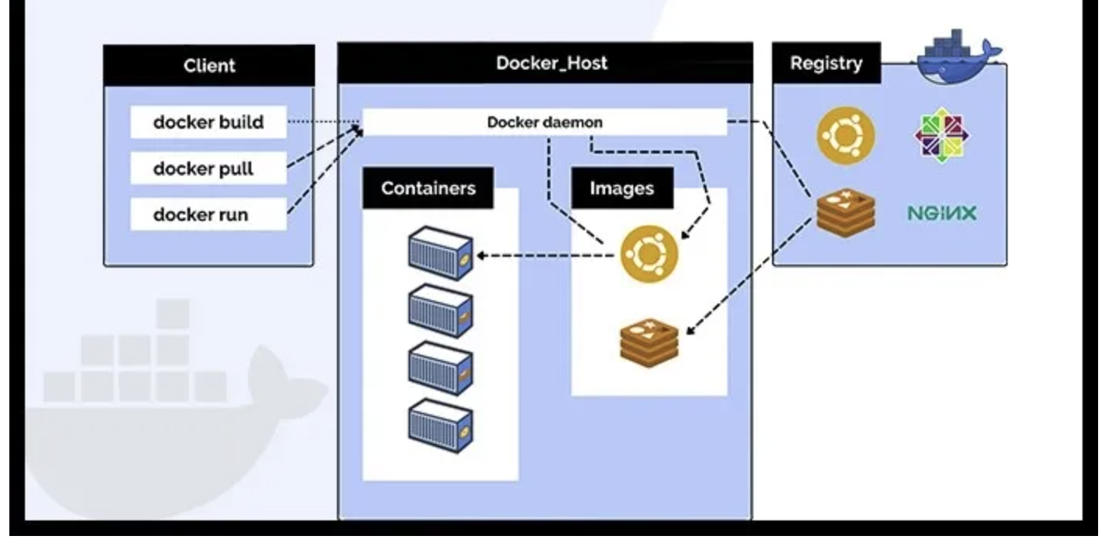
Docker Components
Docker Client
Docker can connect to the host remotely and locally.
Docker Image
Hold the entire metadata that elaborates the capabilities of the container.
Read-only binary templates in YAML.
Docker Daemon
runs as a background process that manages parts like Docker networks, storage volumes, containers, and images.
start up command to client converts to HTTP API call to the daemon
only respond to the Docker API requests to perform the tasks.
Docker Networking
Establishing communication between containers.
E.g. bridge
Docker Registry
Location were docker images are stored
Docker Hub is the default storage location
Docker Container
instance of an image that can be
created, started, moved, or deleted through a Docker API.
Notes:
client-server architecture
Docker Hub is public registry

Slide 14
Demystify some questions
Good alternative for Docker? Buildah, RunC, LXD, Podman, Kaniko
Is it preferable to run more than one application in a single Docker container?
Experts always advise running a single application in a Docker container.
Attain better isolation, make it easier for building, testing, and scaling the application.
What is the difference between Podman and Docker?
Docker uses Daemon as a component whereas Podman follows a daemonless architecture.
Podman needs another tool to manage services and support running containers in the background.
Systemd can also be integrated with Podman allowing it to run containers with systemd
Docker can build container images on its own. Podman requires the assistance of another tool called Buildah

Slide 15
Install docker
Prereq: Linux
docker -v
$ docker: command not found
https://docs.docker.com/engine/install/

Slide 16
How to run a container
Container image can either be built locally or “pulled” from a registry
Commands to pull a sample image and run it
This pulls from the public docker registry
$ docker pull python:3.7
$ docker run python:3.7
Tries to find a local image, else pulls it
$ docker run python:3.7
Unable to find image 'python:3.7' locally
3.7: Pulling from library/python

Slide 17
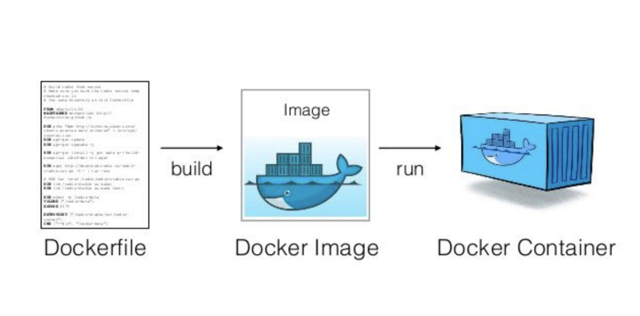

Slide 18
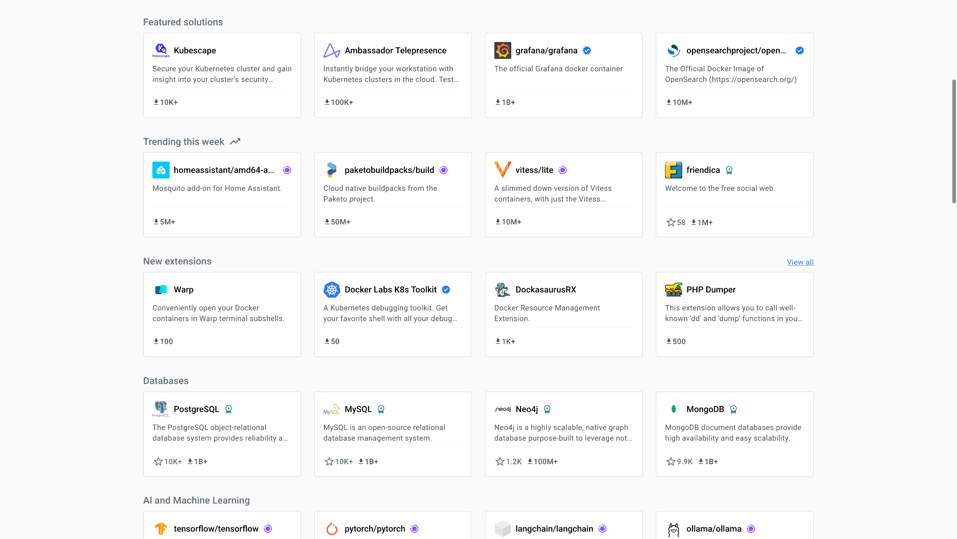

Slide 19
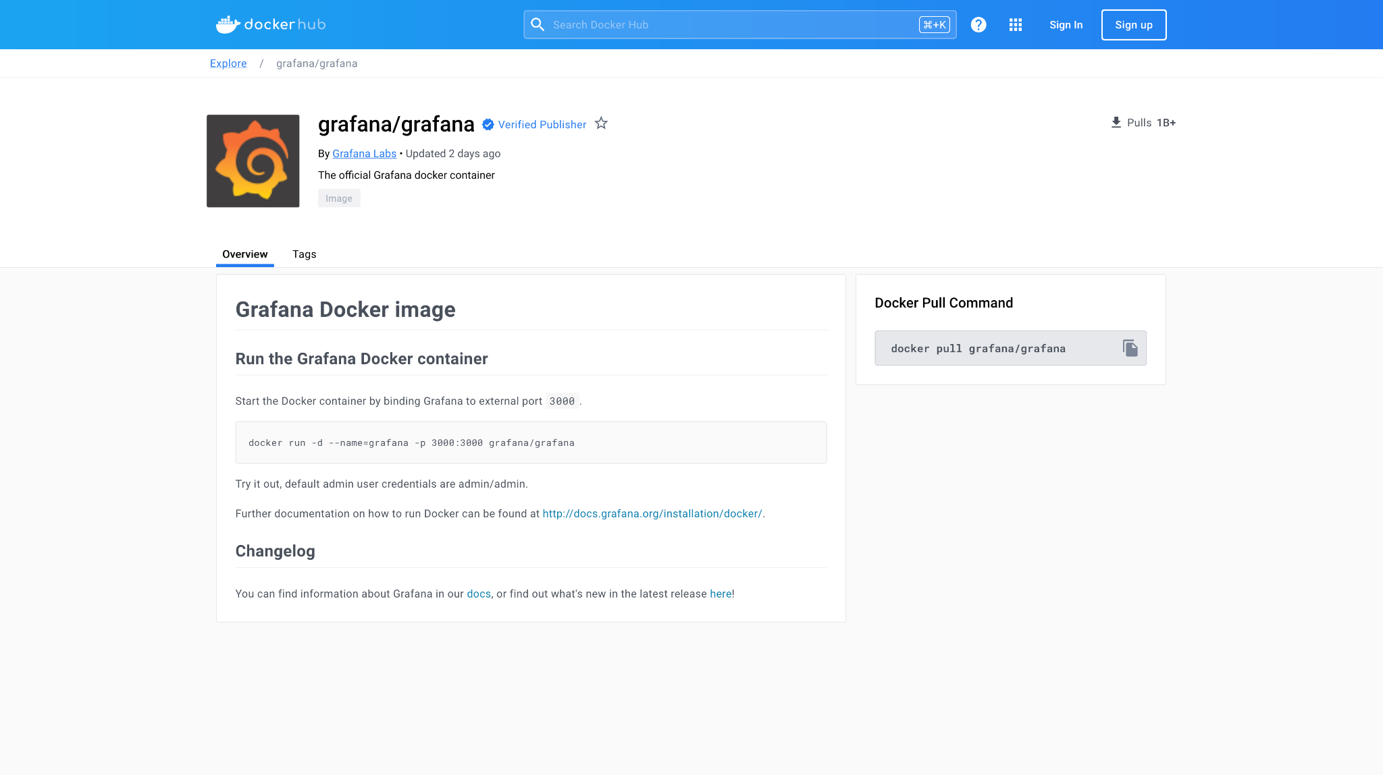

Slide 20
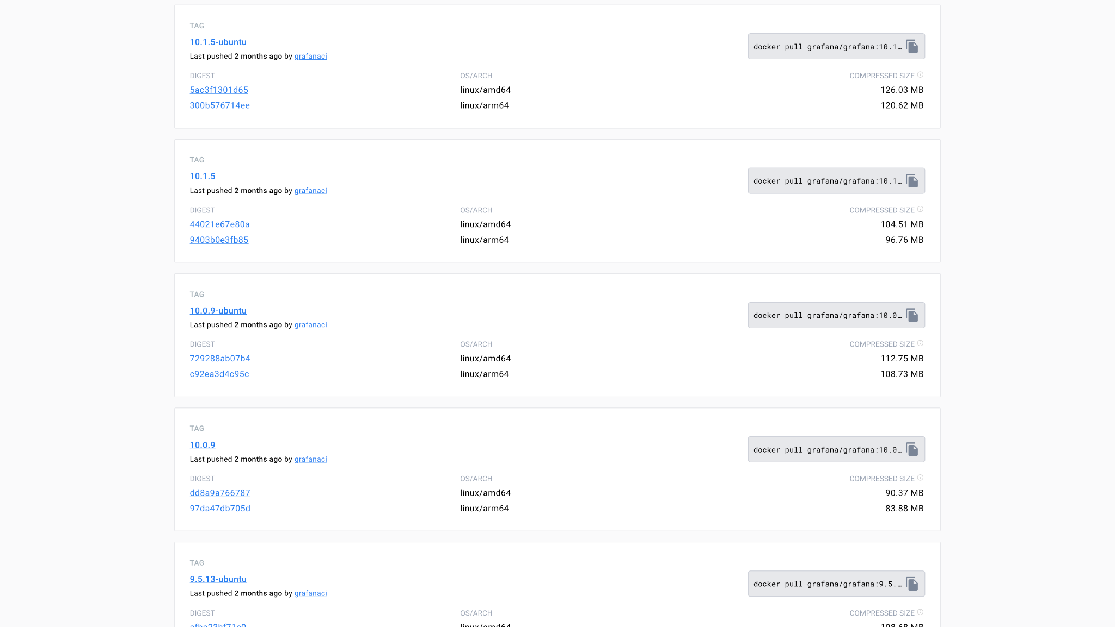

Slide 21
Let’s run a container
Will pull the image and start running it
2023/12/11 13:30:57 [notice] 1#1: start worker process 94
$ docker run nginx
$ docker ps
Lists all containers on the system
CONTAINER ID IMAGE COMMAND CREATED STATUS PORTS NAMES
e036efae11db nginx "/docker-entrypoint." 3 min. ago Up 3 min. 80/tcp sweet_mccarthy
$ docker inspect <cid>/<name>
Very useful to examine the container and debug

Slide 22
Docker Image Size Investigation
If you see docker disk full issue you can use following command to debug
docker images --format "table {{.Repository}}\t{{.Tag}}\t{{.Size}}" | sort -hr -k 3
In a image to check which layer is largest
docker history <imageid>
Delete all unused images
docker system prune -a

Slide 23
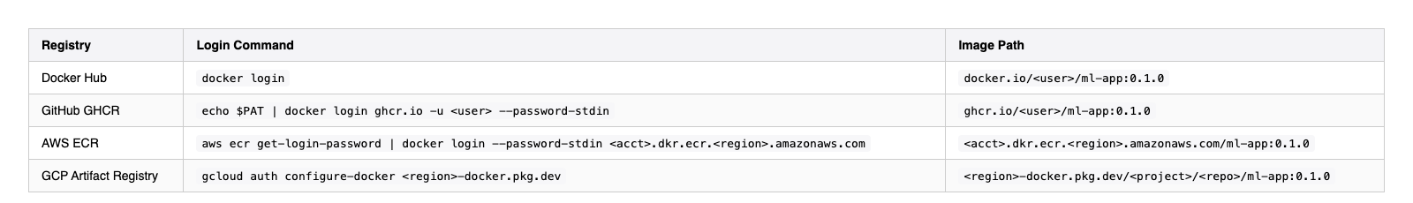
Publishing image
# 1. Log in (use a Quay robot account token, not your password)
docker login quay.io -u <quay-username>
# Password prompt
# 2. Tag for Quay: quay.io/<namespace>/<repo>:<tag>
docker tag ml-app:v1 quay.io/myorg/ml-app:0.1.0
# 3. Push
docker push quay.io/myorg/ml-app:0.1.0

Slide 24
Docker compose
Allows to run multi-container applications - before kubernetes etc.
You specify multiple docker containers and it brings them all up.
It sets up a single network for your entire application, all containers join them and can reach each other on this network.

Slide 25
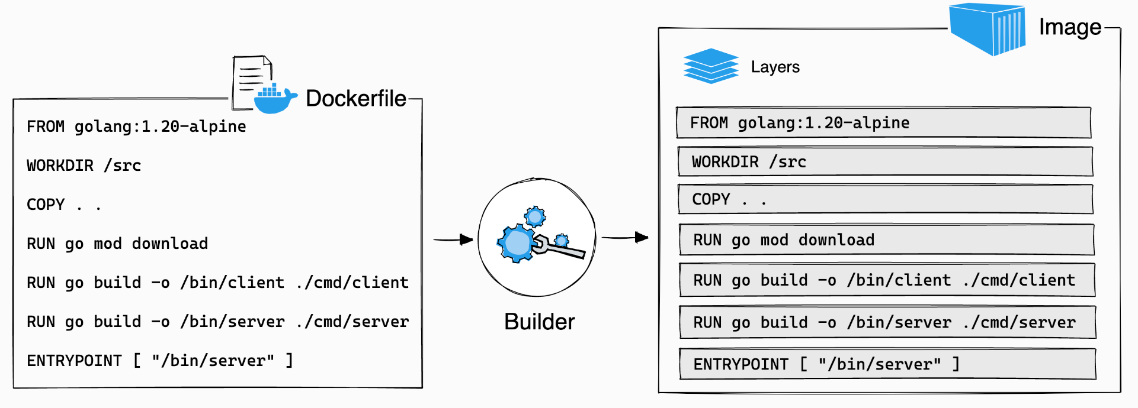
Docker internals - layers

Slide 26
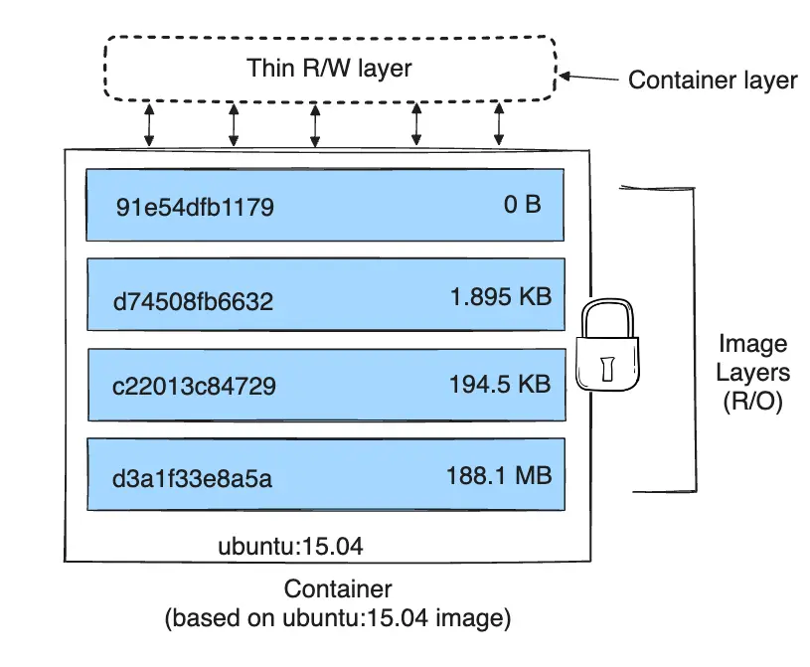
Layers
Docker image is built as a series of layers, each layer represents a line in the Dockerfile.
Every command that modifies the filesystem is a new layer.
The layer only captures the diff from the previous layer.
Layers are shared across different images.
When we run a container, a new writable layer (called container layer) is created. Other layers are read-only.
https://docs.docker.com/storage/storagedriver/

Slide 27
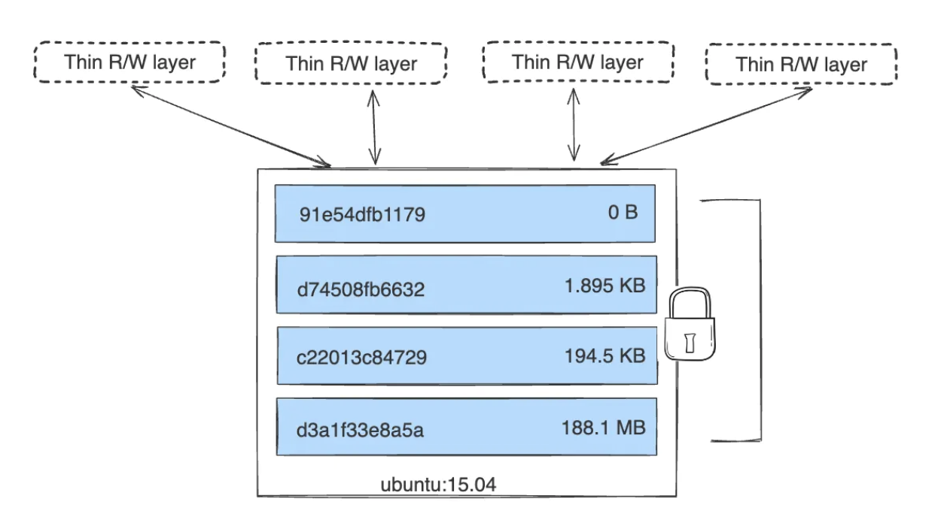
Layers
https://docs.docker.com/storage/storagedriver/

Slide 28
ml-app-docker example
docker build -t ml-app:v1 .
docker run -d --name mycontainer1 -p 8000:8000 ml-app:v1
# In another terminal:
curl http://localhost:8000/health
curl -X POST http://localhost:8000/predict \
-H "Content-Type: application/json" \
-d '{"texts": ["I love this!", "This is awful."]}'
Expected response:
{"predictions":[
{"text":"I love this!","label":"POSITIVE","score":0.9998},
{"text":"This is awful.","label":"NEGATIVE","score":0.9997}
]}

